Slide 1
Changes in the Health Care Marketplace: How Can Communities and Locals Respond?
Jessica L. Curtis
Senior Advisor, Hospital Accountability Project
HPAE
Atlantic City, New Jersey
10/6/16

Slide 2
Agenda
Introduce Community Catalyst
Unpack ways consumers—your patients, and you—may be impacted by market changes
Identify ways consumer advocates—our “base”—and locals can mobilize in response
© 2016

Slide 3
Who We Are
Community Catalyst is a national non-profit advocacy organization that works with national, state and local consumer organizations, policymakers and foundations to build consumer and community leadership to improve the health care system.
We support consumer advocacy networks that impact state and federal health care policy, and ensure consumers have a seat at the table as health care decisions are made.
© 2015

Slide 4
Health care: It’s a tug of war out there.
Community Catalyst is a national non-profit advocacy organization that works with national, state and local consumer organizations, policymakers and foundations to build consumer and community leadership to improve the health care system.
We support consumer advocacy networks that impact state and federal health care policy, and ensure consumers have a seat at the table as health care decisions are made.
Payers (Insurers)
Providers
© 2015

Slide 5
Market Concentration
Hospital Markets
49% highly concentrated (in English, this means there’s not a lot of competition or choice)
32% moderately concentrated
19% unconcentrated
Insurers
72% highly concentrated
(Note that the degree of insurer concentration can vary by market segment—Medicare Advantage; non-group; small group)
© 2016

Slide 6
Recent Merger Activity
Recent waves of merger activity have attracted a lot of attention; especially the proposed big-insurer mergers
Anthem-Cigna
Centene-Health-Net
Aetna-Humana
There is also a lot of hospital system expansion, both horizontal (hospital systems combining) and vertical (hospitals acquiring physician practices). The big driver for this? Affordable Care Act innovations like “Accountable Care Organizations” (ACOs).

Slide 7
What does all of this mean for consumers???

Slide 8
Making the Case for Competition
Benefits of Provider Competition
Lower prices
More responsive patients
Benefits of Insurer Competition
Choices of plans
Lower premiums
© 2016

Slide 9
But…competition isn’t always enough to protect us.

Slide 10
Problems With Provider Competition
Historically has taken the form of a medical arms race, not lower prices
Payment reforms included in the ACA (like accountable care organizations) could change this but could also encourage competing providers to engage in the same kind of risk-selection that insurers have historically done
Hamper efforts to take concerted actions to address community health
Each provider system is only responsible for a small and shifting share of the population
Many communities are not large enough to sustain competing delivery systems so regulatory approach needed
© 2016

Slide 11
Problems With Insurer Competition
Excessive administrative cost of US health system largely a function of insurer competition
about $90-$150 billion/ year
Competing insurers with relatively small market share cannot bargain effectively with providers for good prices
More actors can mean bad actors
Because they have few other tools, most small insurers rely on "anti-social" approaches to keep costs in check
Example: discriminating against sick people in benefit design or network design (they used to just keep "those people" out but ACA doesn't allow them to do that anymore)
© 2016

Slide 12
What We Know And What We Don’t Know
Evidence suggests that provider market concentration leads to higher prices
Evidence suggests that insurance market concentration holds down provider prices, but may not translate to lower premiums.
Recent evidence from exchanges suggests that having more carriers in a Marketplace leads to lower premiums but there are some weaknesses in this evidence.
Specifically, not clear that first year premiums reflected cost of enrollees.
Evidence from Medicare Advantage is that plan mergers raise premiums

Slide 13
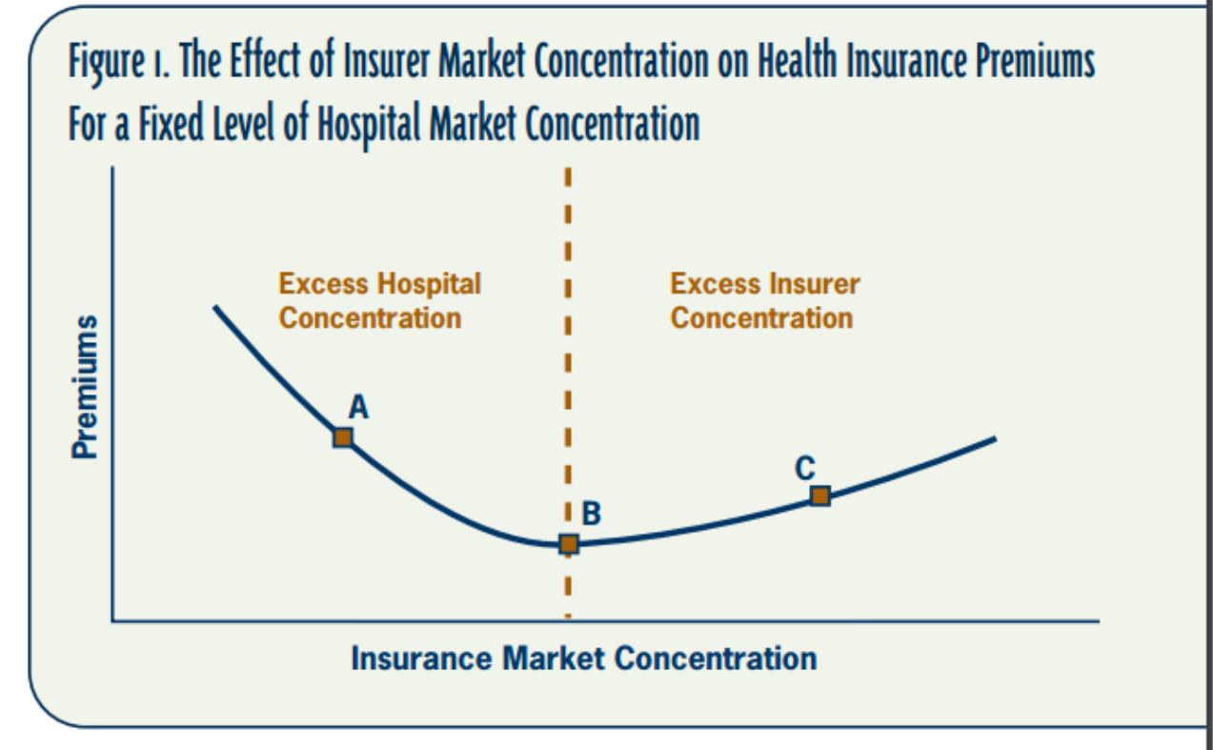
Insurer Market Concentration
Probably not a linear relationship between more plans and lower cost

Slide 14
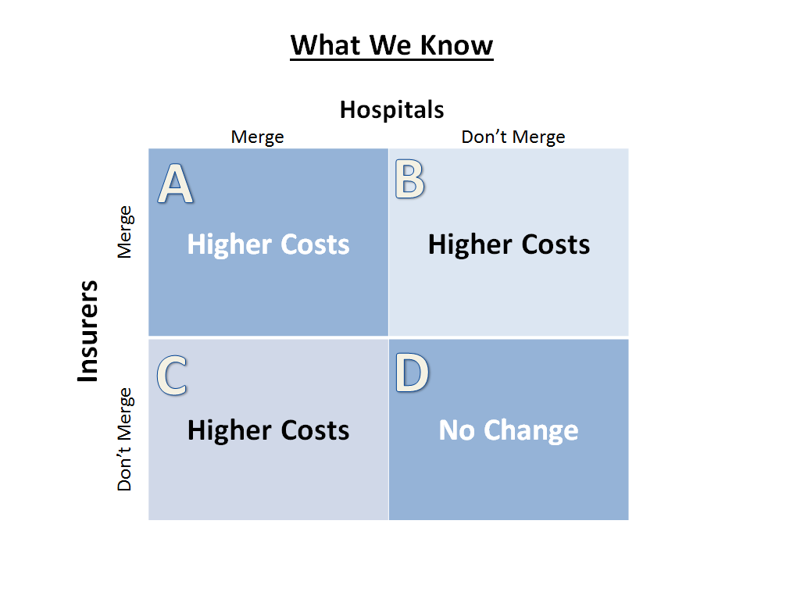
© 2011

Slide 15
How Should Advocates Respond?
Just say no?
Perhaps not….
Why not?
© 2016

Slide 16
What Will Happen?
How do we imagine efforts to control health care costs will work over the long run if we block potential innovations to integrate care and reform pay incentives?
Do we really think competition between plans and between providers will hold down health spending?
Only US relies heavily on competition to contain health care spending
How well is that working out for us?
Generally other countries use strong purchasing/ price regulation/set a health care “global” budget
A few states are experimenting w/ this approach--MD, MA, VT

Slide 17
Most Of The Damage Has Already Been Done
Markets are already highly concentrated
No evidence of willingness or ability to unwind previous mergers
Blocking insurance mergers without blocking hospital mergers doesn’t reduce consumer costs
Source: www.quora.com

Slide 18
A Final Dilemma: Political Power
Even though regulating fewer big entities becomes easier technically, do giant insurers and providers amass so much political power that they are able to capture or discourage regulators and legislators?
© 2016

Slide 19
The Good Old Revolving Door…
“Drinks, junkets and jobs: How the insurance industry courts state commissioners”
October 2, 2016
Notes:
Source: https://www.washingtonpost.com/investigations/drinks-junkets-and-jobs-how-the-insurance-industry-courts-state-commissioners/2016/10/02/1069e7a0-6add-11e6-99bf-f0cf3a6449a6_story.html

Slide 20
Okay…so what’s a local to do??

Slide 21
Don’t mourn.

Slide 22
In the Short Run…
Use the merger transaction to extract concessions
(Insurers) commitments around network adequacy or how out-of-network bills will be handled
Limits on premium increases or agreement to stepped up oversight/ enforcement by Department of Insurance
(Hospitals) commitments around financial assistance and community benefits and community engagement
Work with community partners to ID common goals
Locals may have access to people, data and relationships, especially on provider side, that community groups can use
Community groups may already know the public policy terrain, especially on the insurance side
© 2016

Slide 23
Build a Strategy (Consumers Union)
Gather information
Assess feasibility – and know your strategy and goal (opposing a merger? proposing a remedy?)
What’s clear, measurable, and enforceable in your state?
Can you target a remedy to meet an existing need?
Develop a broad list of remedies knowing some will lose
Comments to regulatory agencies – “flooding the zone” with complaints
© 2011

Slide 24
Six Specific Activities (Consumers Union)
Testify at hearings (and ID policyholders who can)
Submit written statements explaining concerns or highlighting problems
Meet with regulators to explain concerns and discuss remedies
Enlist support of state legislators at various points in the regulatory process
Reach out to community members to engage them and hear their concerns and ideas
Educate the media about prior mergers and what’s at stake
© 2011

Slide 25
Concessions (from Consumers Union)
Conduct/behavioral remedies
Pricing restrictions (really turn on state regulatory environments and access to data)
Require insurer to expand to new markets to increase competition and consumer choice (e.g. Florida)
Tie to quality and performance improvement
Invest in health infrastructure (rural health, consumer assistance, data collection, health sector employment)
Charitable giving requirements
Require corporate presence to stay or create in-state jobs

Slide 26
Consider community benefit as an “evergreen” opportunity to address high costs and community health needs.

Slide 27
Hospital Billing & Financial Assistance
© 2011

Slide 28
Percentage of collection accounts on credit reports attributable to medical debt: 52
Americans with a medical account in collections: 43 million (CFPB)
Percentage of the population impacted: 13 (at least)
Notes:
Sources: NerdWallet analysis of Ernst and Young 2014 report on third-party debt collection https://www.nerdwallet.com/blog/health/managing-medical-bills/medical-bills-debt-crisis/
Stone, C. “Here’s How Medical Debt Hurts Your Credit Report,” Consumer Financial Protection Bureau (December 11, 2014). Accessed May 24, 2016 at http://www.consumerfinance.gov/about-us/blog/heres-how-medical-debt-hurts-your-credit-report/.
Cohen, R. and Kirzinger, W. “Financial Burden of Medical Care: A Family Perspective,” Centers for Disease Control and Prevention; NCHS Data Brief No. 142, January 2014. Accessed May 24, 2016 at http://www.cdc.gov/nchs/products/databriefs/db142.htm.
Evans, M. “More Underinsured as High Deductibles Proliferate,” Modern Healthcare (May 20,2015). Accessed May 24, 2016 at http://www.modernhealthcare.com/article/20150520/NEWS/150519878?utm_source=modernhealthcare&utm_medium=email&utm_content=externalURL&utm_campaign=am.

Slide 29
This little piggy is underwater.
Credit: Shutterstock
Notes:
Source: Jost, T. “Affordability: The Most Urgent Health Reform Issue for Ordinary Americans,” Health Affairs blog (February 29,2016). Accessed May 24, 2016 at http://healthaffairs.org/blog/2016/02/29/affordability-the-most-urgent-health-reform-issue-for-ordinary-americans/.

Slide 30
ACA Requirements
Financial assistance and collections policies – written out, board approved, available to the public in multiple languages
Fairer charges for those who qualify
Better protections against aggressive debt collection
Regular process for assessing community health needs and driving strategies to address SOME of the needs (with community input – labor mentioned)
FINE PRINT: This does not apply to for-profit hospitals or other types of medical providers.

Slide 31
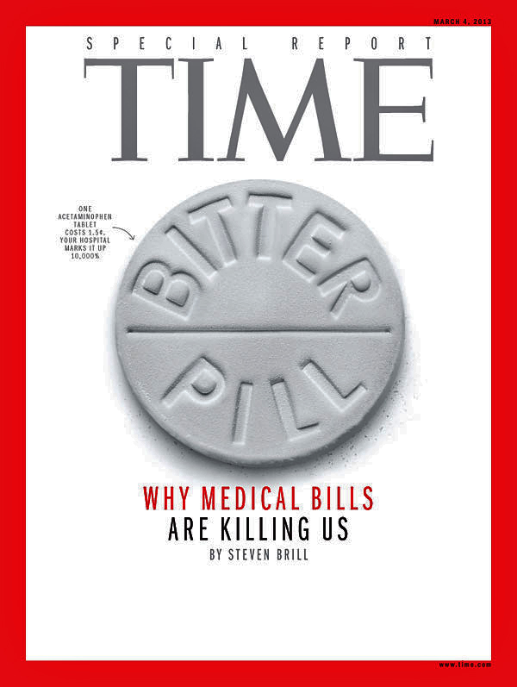
What’s the Problem?
50 hospitals charge uninsured more than 10 times cost of care, study finds
CFPB Study Finds Medical Debt Overly Penalizes Consumer Credit Scores
Prognosis: Profits

Slide 32
A contributing factor in the recession…
“I was told that in order to have the surgery, I would have to pay half the amount. Not knowing what else to do, I gave them my credit card, and it was charged $4,000.00. […] I am now months behind on my mortgage.”
- Daisy, unemployed, Orlando
Notes:
The average uninsured person can afford to pay in full about 12% of hospitalizations, or just 5% of the total amount hospitals bill
For those earning above 400% of the FPL, only 37% of hospitalizations can be paid in full, or 4% of the total amount billed by hospitals
These figures do not include the cost of physician fees, ambulance fees or post-acute care expenses, and assume that the uninsured is willing and able to use all of their financial assets to cover the cost of hospital bills. Uninsured have fewer assets than the insured, even at higher income levels.

Slide 33
NJ Markups: 500-600% of costs
Gross patient service revenue – what hospitals would make if they were paid at the rates they charge
Charge = hospital’s “sticker price”
Cost = what the hospital spent to provide the service
Net patient service revenue – what hospitals actually collect, after subtracting:
Financial assistance (charity care) to patients unable to pay
Contractual rates negotiated with insurance companies, Medicare, Medicaid
Notes:
Number one in the nation – National Nursed United data, 2001-2012 http://nurses.3cdn.net/966a1174efbe3f9ad1_39m6bntzv.pdf. See also http://nurses.3cdn.net/e2086b18382cb8e96d_0dm6b5ad3.pdf listing out hospitals. Ge Bai data shows Carepoint-Health Bayonne is one of the top 4 in the nation, at 1200 percent. http://www.cbsnews.com/news/50-hospitals-with-markups-of-around-1000-percent/. Greater Philly area is another hotspot, and for-profit operators tend to be more expensive.

Slide 34
So, how are hospitals doing?
Noncompliance
Don’t address the underinsured
Charity care numbers are down, bad debt numbers are up
Unclear whether staff are being trained effectively to share information on financial assistance with patients in a timely way
Unclear whether hospitals are really changing contracts with third-party debt collectors and debt buyers
Language access to financial assistance and billing information is poor

Slide 35
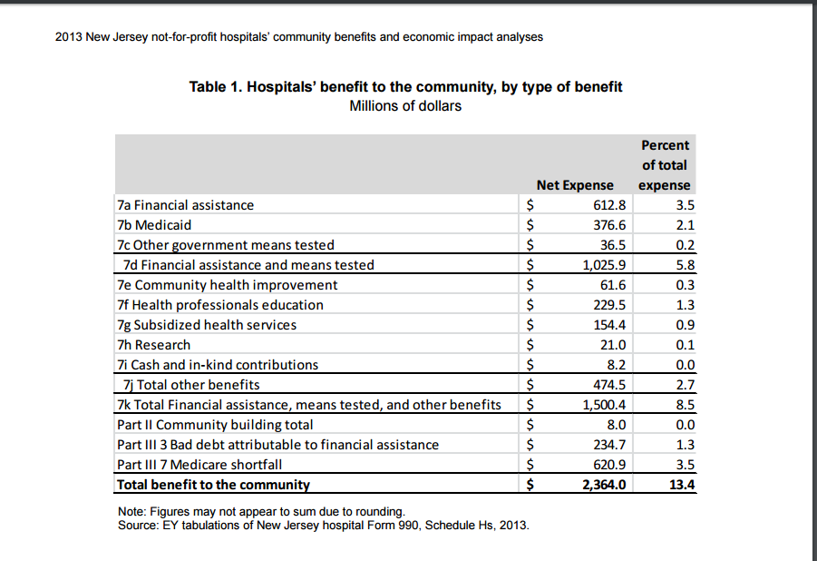
And how are New Jersey hospitals doing?
© 2014
Notes:
Ernst & Young analysis, 2015 (using Schedule H data): http://www.njha.com/media/448628/eyreport.pdf

Slide 36
Ripe for the picking…
Secret shopper, staff training
Surveying local members and community members about medical debt
Hiring bilingual and multilingual staff
Getting involved in next round of
community benefit planning
Getting data (if possible) on
contracts with third-party collections
Including standards for collections,
community health priorities in contracting
Push for state laws that go beyond the ACA (applicable to all providers, address underinsured)

Slide 37
What the Hospital Community Benefit Process Looks Like
Gather information about the community’s health
Involve the community and public health
Prioritize what needs to address; publish assessment report
Implement programs and report yearly on progress
Evaluate Impact
Define the community
© 2014

Slide 38
Resources
Community Catalyst, “Health Market Consolidation”
Consumers Union Health Care Value Hub, “Advocates Guide to Health Insurance Mergers”
Merger Watch, “When Hospitals Merge”
Community Catalyst, Hospital Checklists (financial assistance policies and community health needs assessments)
© 2011

Slide 39
Questions? jcurtis@communitycatalyst.org 617-275-2859
© 2016

Slide 40
Thank You

